Slide 1


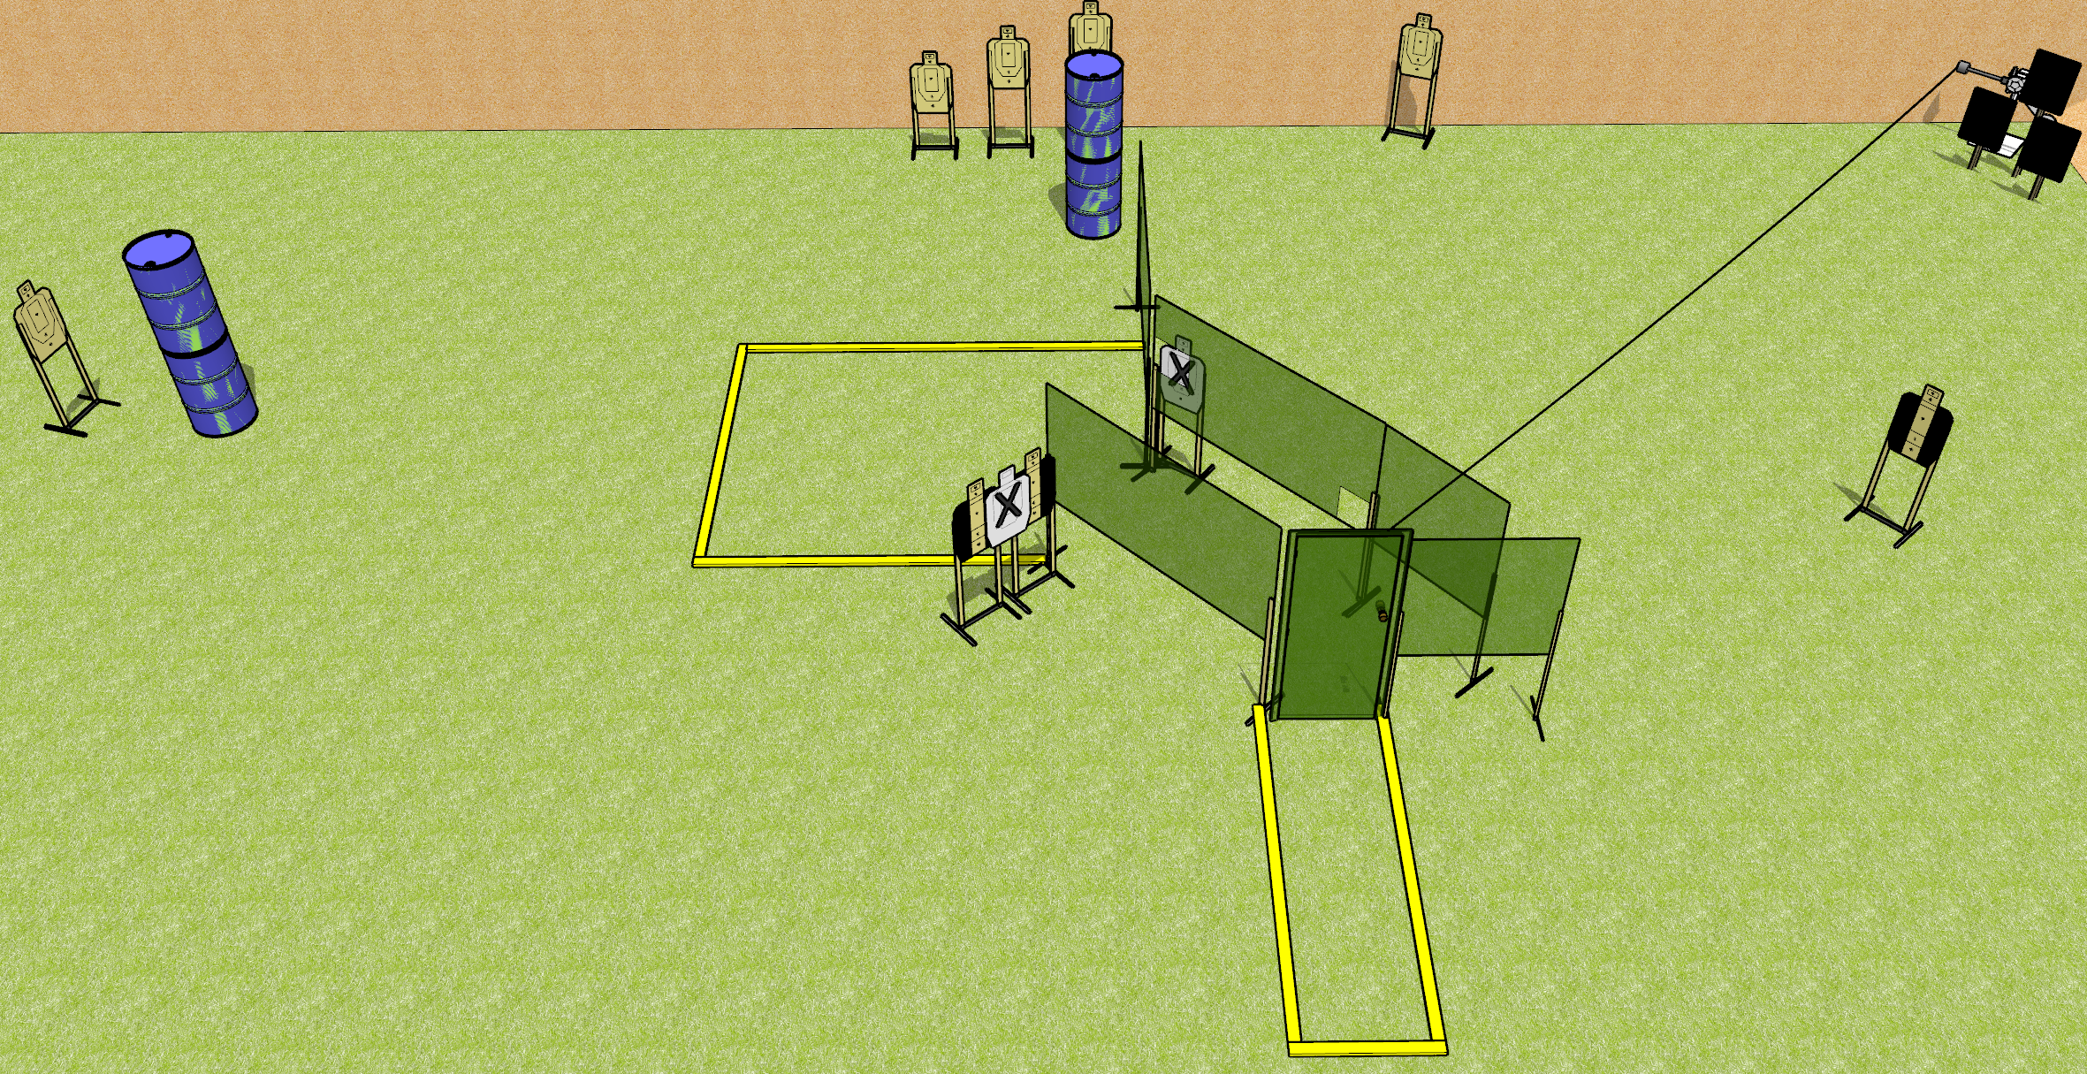
 | Dothan Gun Club – USPSA Match Out on a Wire Course Designer : Drew Coleman
Round Count 18 rounds 8 USPSA targets, 2 falling plates
Equipment List 9 wall feet Red stitch swinger + plates Door

Slide 2
Out on a Wire
Written Stage Briefing
Out on a Wire is an 18 round, 90 point, Comstock medium course. There are 8 USPSA targets and 2 falling plates. The best 2 hits on paper will score, and steel must fall to score. The start signal is audible.
The metal target is activated by opening the door, and must be activated before being engaged. Please check the activator prior to walkthrough and set it the same way every time.
Handgun start position is inside the shooting area, facing uprange, toes touching most uprange fault line, wrists above shoulders. Handgun is loaded and holstered.
PCC start position is inside the shooting area, facing downrange, heels touching most uprange fault line. Loaded carbine is held with both hands, stock on belt, safety on.
On start signal, engage targets as they become available from within the shooting area.

